Slide 1

Clustering & Segmentation
Using Unsupervised Learning
K-means Algorithm
By Sriramya Kannepalli

Slide 2
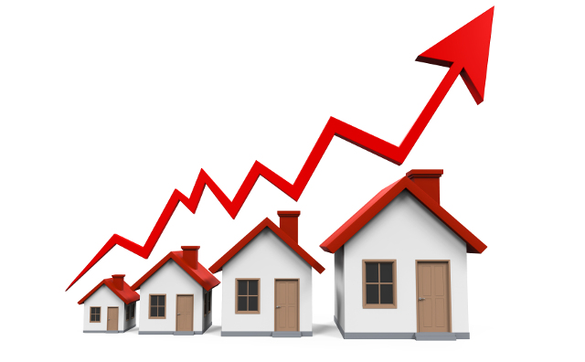



Housing Sale Prices and Venue Data Analysis
Holiday Venue Recommendations
City Development Ideas
New Restaurant Locations

Slide 3
Let’s get started -
Convert addresses into their equivalent latitude and longitude values
Location Data Providers - Foursquare API to explore Neighborhoods
K-means clustering algorithm
Folium library to visualize the neighborhoods of Manhattan City and their emerging clusters

Slide 4


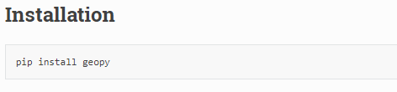
Geopy is a Python 2 and 3 client for several popular geocoding web services.
Geopy makes it easy for Python developers to locate the coordinates of addresses, cities, countries, and landmarks across the globe using third-party geocoders and other data sources.
Geopy includes geocoder classes for the OpenStreetMap Nominatim, Google Geocoding API (V3)
Nominatim
Python Code:

Slide 5
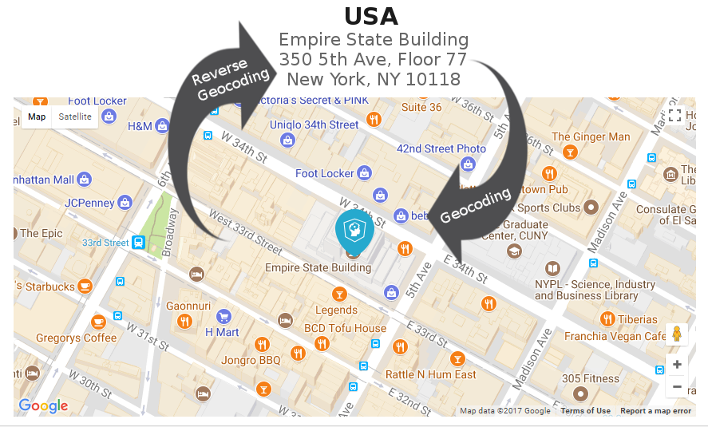
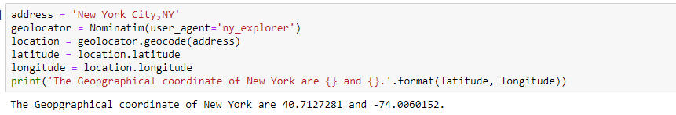
“Geocoding is the computational process of transforming a physical address description to a location on the Earth's surface. Reverse geocoding, on the other hand, converts geographic coordinates to a description of a location, usually the name of a place or an addressable location.”
Python Code:

Slide 6
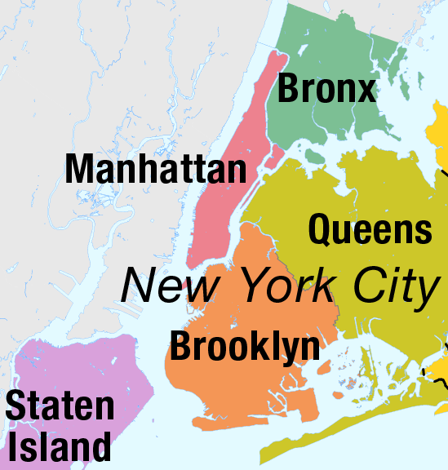
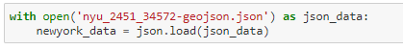
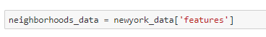
New York City - 5 Boroughs & 306 Neighborhoods

Slide 7
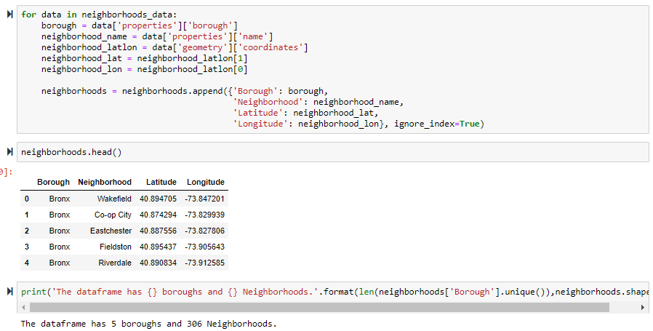
Python Code:
“Pandas is a software library written for the Python programming language for data manipulation and analysis. Offers data structures and operations for manipulating numerical tables and time series.” - Wiki

Slide 8
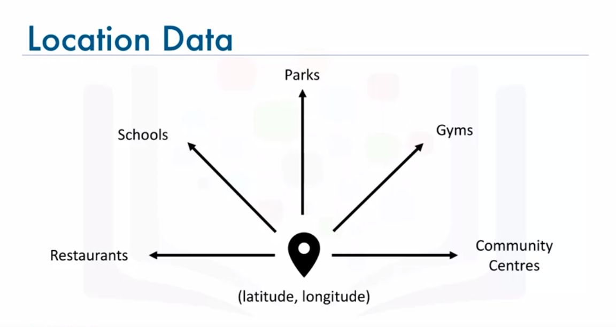

Slide 9
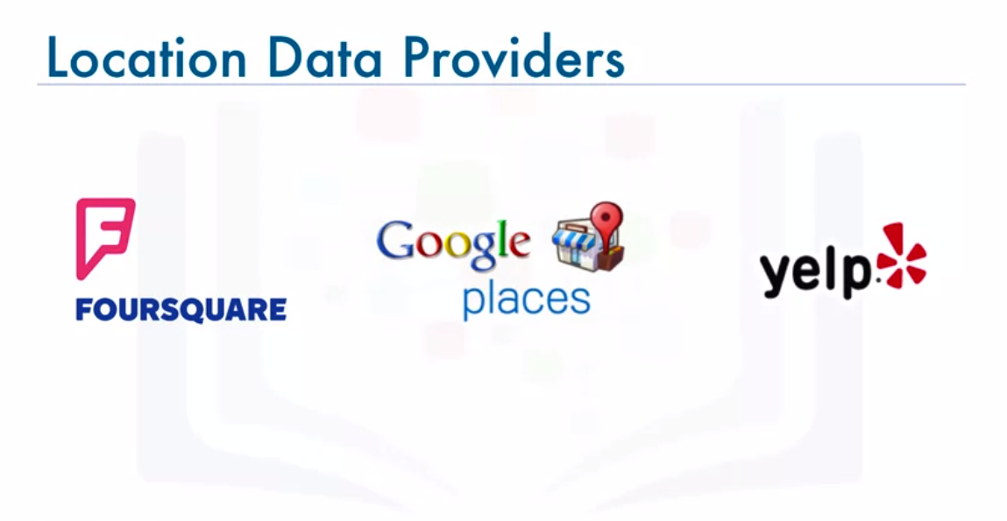
The Foursquare API has a limit of 950 Regular API Calls per day and 50 Premium API Calls per day for Sandbox Tier Accounts.
By verifying your account using a credit card, you may upgrade to the Personal Tier to increase this limit to 99,500 Regular API Calls per day and 500 Premium API Calls per day.

Slide 10
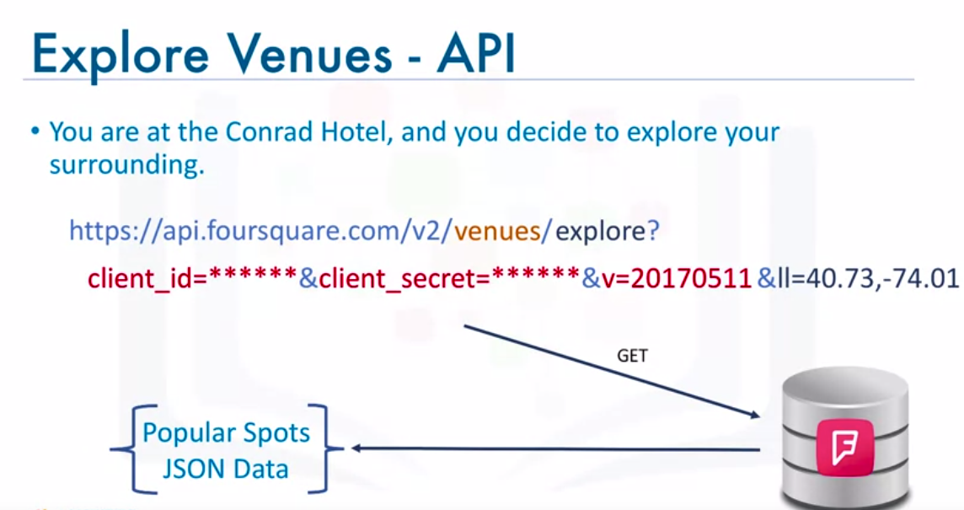
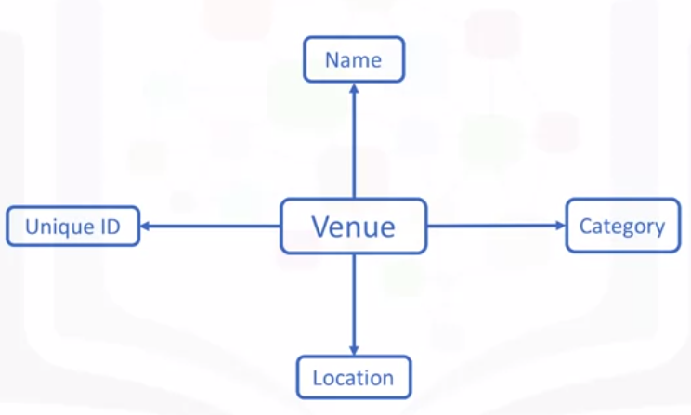
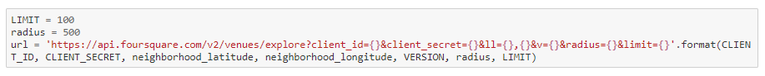
Python Code:

Slide 11
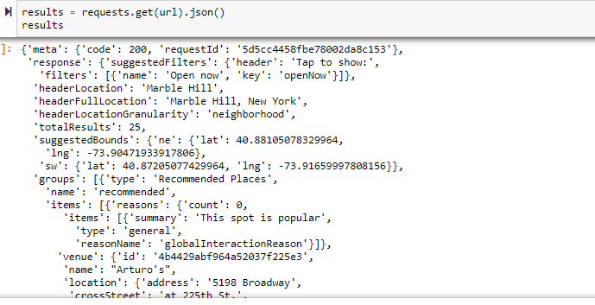
Python Code:

Slide 12
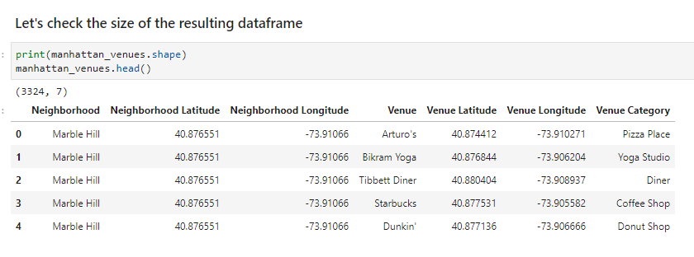

Slide 13
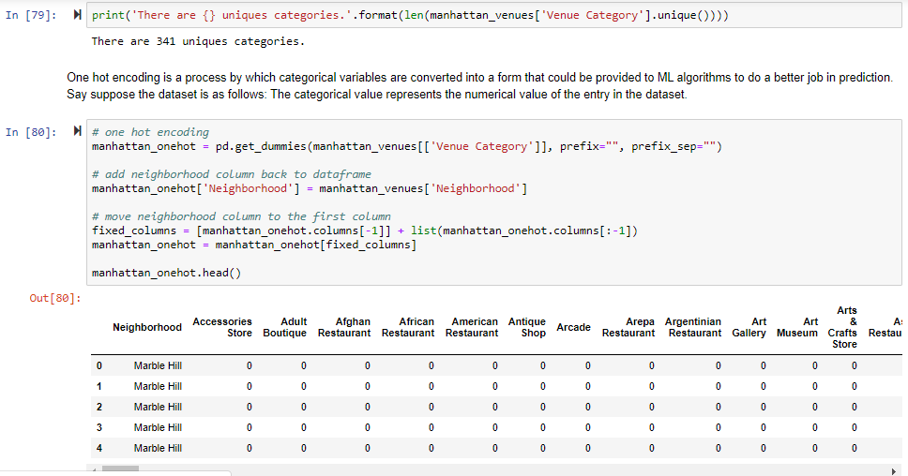

Slide 14
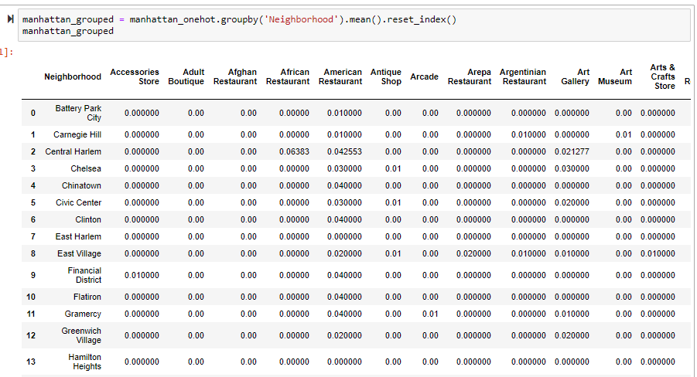

Slide 15
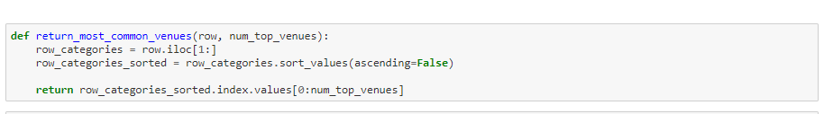
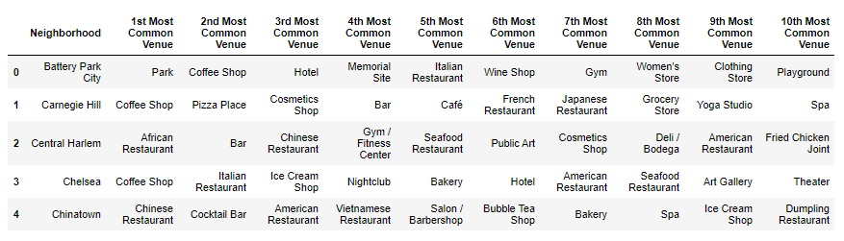

Slide 16
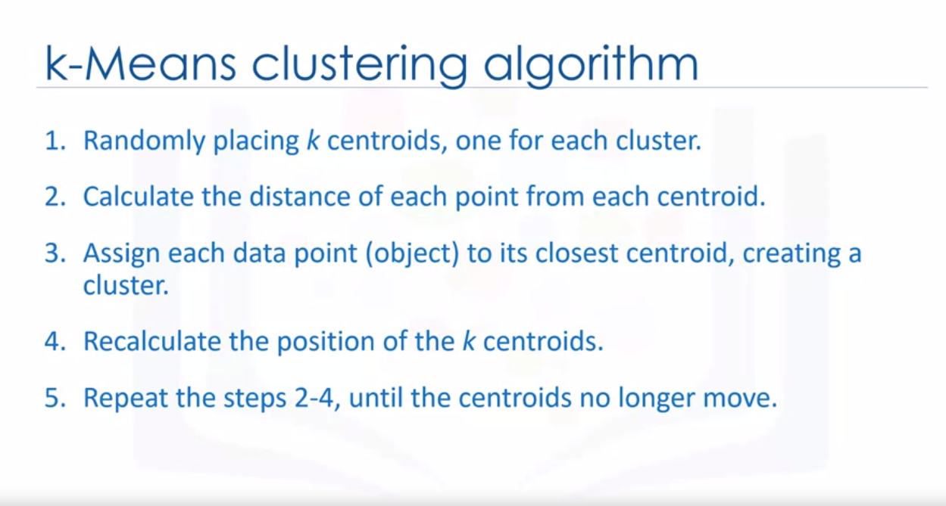

Slide 17
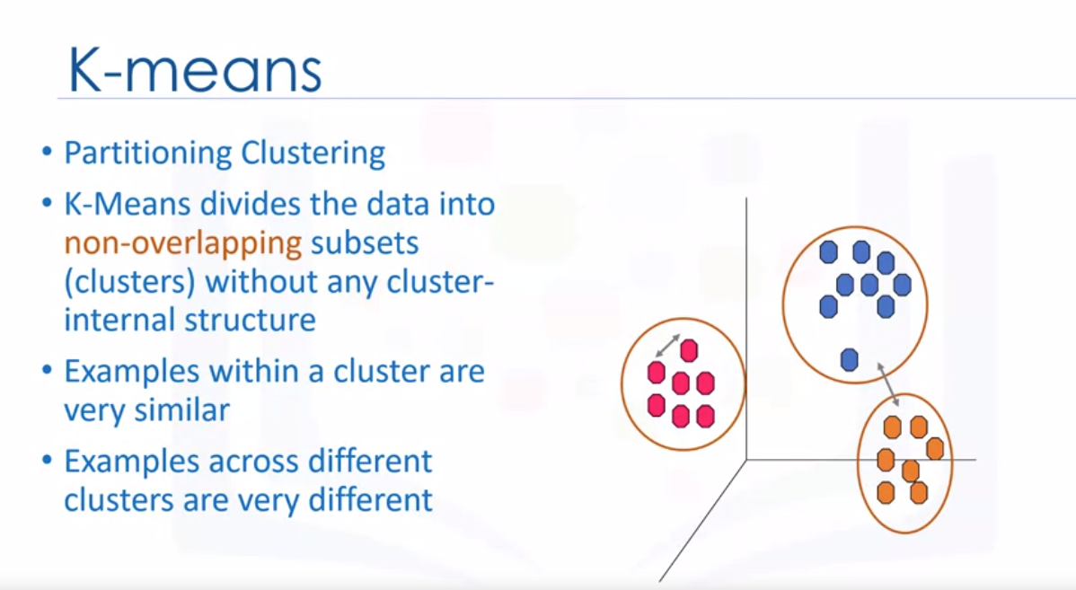

Slide 18
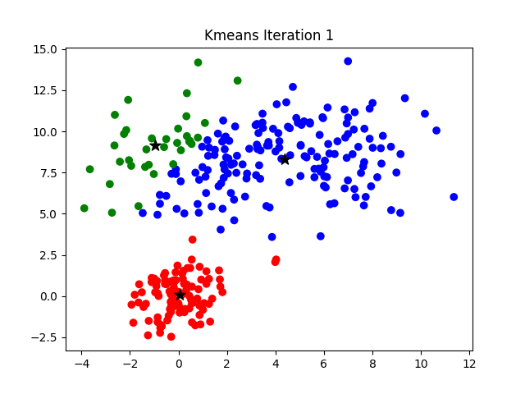
Fig: Source

Slide 19
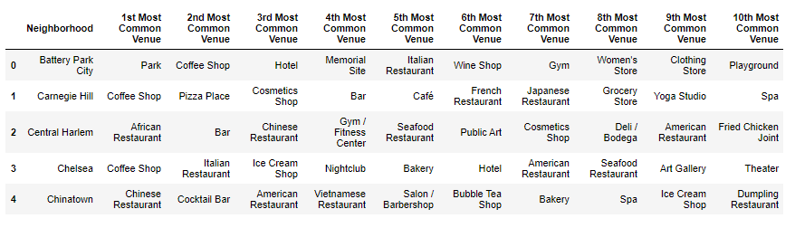

Slide 20
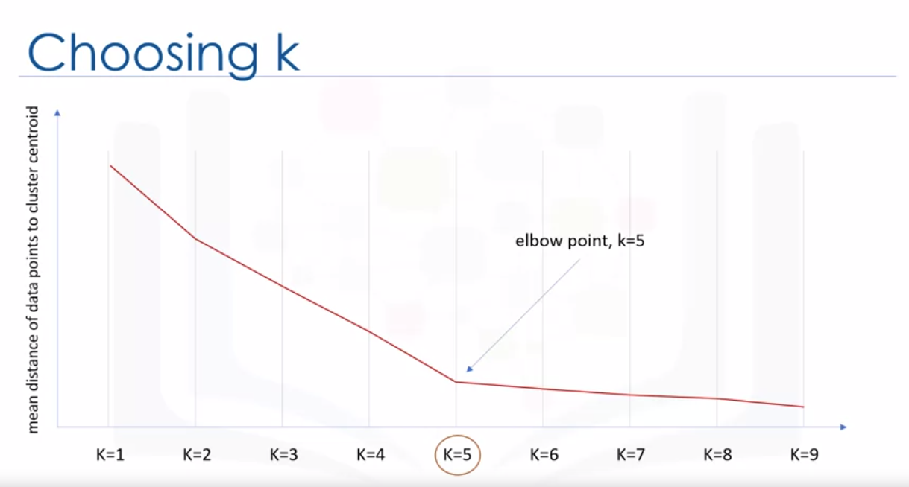

Slide 21
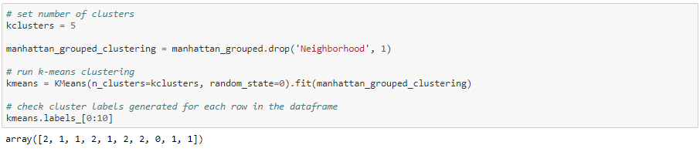
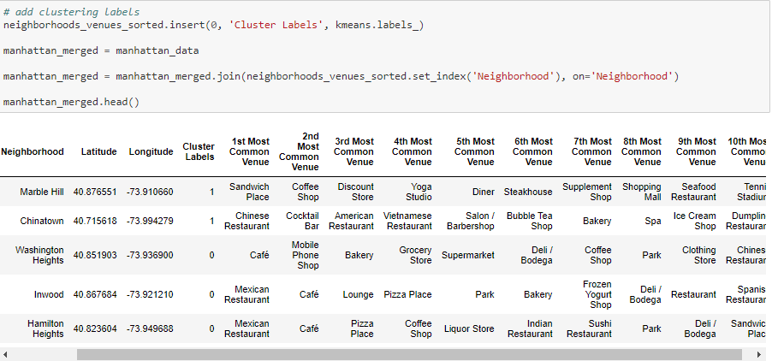


Slide 22
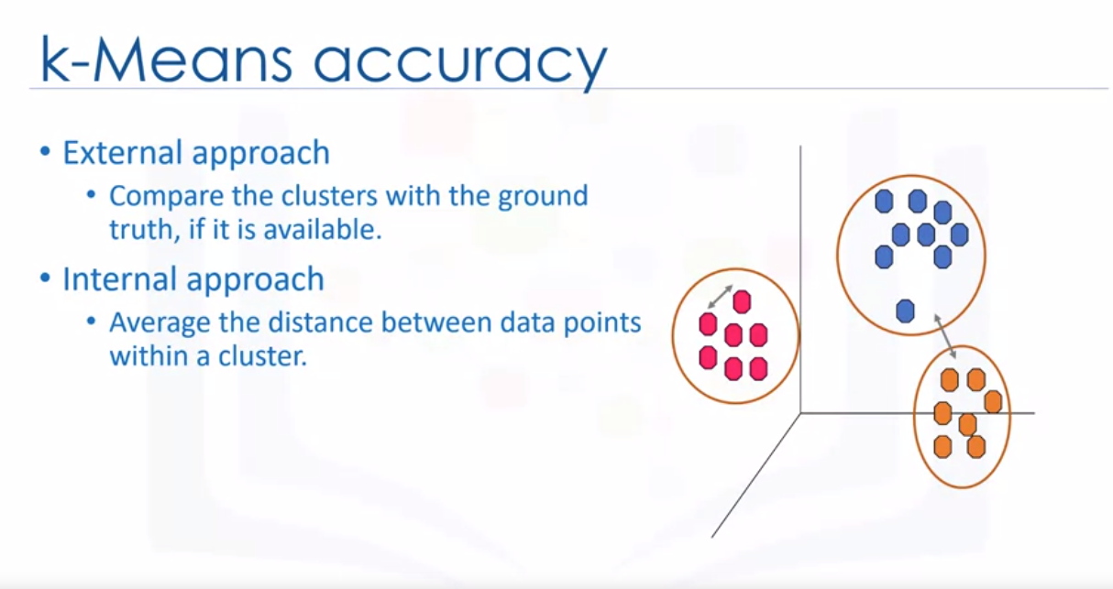

Slide 23
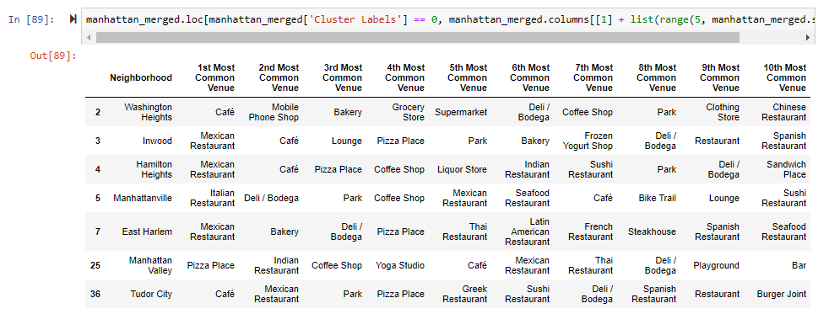

Slide 24
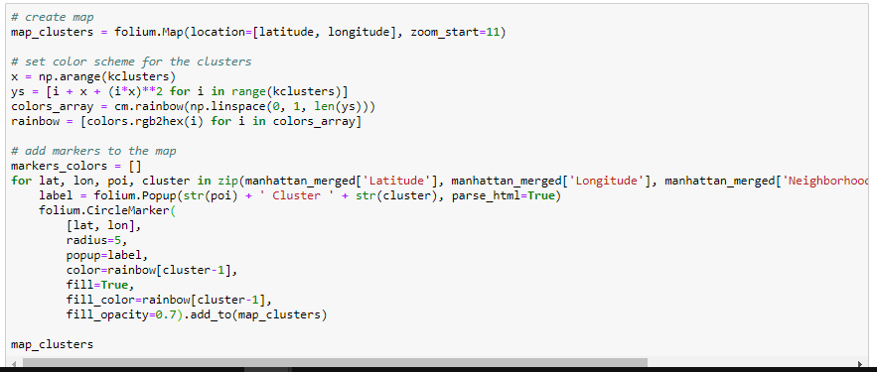
Python Code:

Slide 25
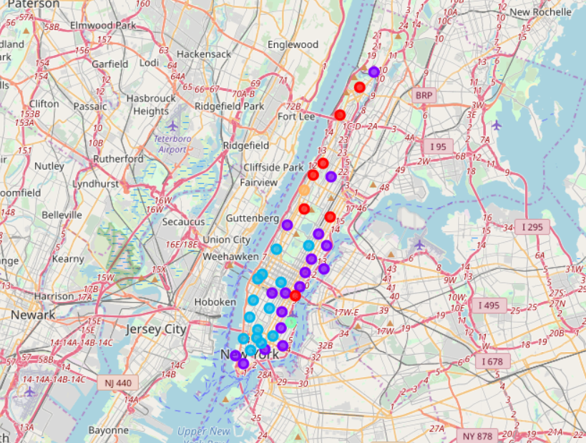
Clustering of Manhattan

Slide 26
References:
https://www.coursera.org/learn/machine-learning
https://www.coursera.org/learn/applied-data-science-capstone
Free Learning Resources for Machine Learning and Deep Learning:
https://www.kaggle.com/competitions
https://course.fast.ai/
http://course18.fast.ai/ml
https://www.coursera.org/specializations/deep-learning
https://www.khanacademy.org
https://medium.com
Code GitHub Link:
https://github.com/SriramyaK/Clustering-Neighborhoods-of-Manhattan-NYC

Slide 27
Similar projects using K-means and location providers:
Housing Sales Prices & Venues Data Analysis of Istanbul
Best Neighborhood in Dubai to open a New Mexican Restaurant
Singapore Visitors and Expatriates Venue Recommendation
Smart City Urban Development plan - Vizag City to model itself as San Francisco

Slide 28

Thank You

